Slide 1

CLANCULARIUS - FEEDBACK SYSTEM
(Infosys internship project)
By
Batch 21-A:
317126510005- Amulya Jyothi Bobbili
317126510020- Gorli Sindhu
317126510023- Gundu Bhargav
317126510025- J Sai Vinay
317126510034- Kotni Laxmi Swarup
317126510051- Mourya Robbi
Department of Computer Science and Engineering
Anil Neerukonda Institute of technology and Sciences

Slide 2
1.Introduction

Slide 3

Feedback is a reaction or information that occurs as a result of actions or behavior undertaken by an individual or group.
Effective feedback helps individuals to understand what they did well and what they could do better.
Once they know what is good and what isn’t, they are able to adapt their behavior and work to improve it.
Thus, feedback is a key tool for improving both individual and team performance.

Slide 4

Influence someone to do something differently or to change their approach.
Show people that you appreciate what they did and give them recognition, which helps to motivate them.
Get information from your manager, team or others regarding your own performance and behavior.
Improve the quality of an individuals’ work or the work of teams.
Show people that you value them and their input.
Help people back onto the right target when they have misunderstood a goal or task.

Slide 5

CLANCULARIUS
Clancularius in Latin means anonymous or writing in secret.
Clancularius is a free feedback form generation application where the user can create his own feedback form and collect responses from others.
It is a full-featured online form builder that makes it easy to create robust forms and collect important data.
It is dedicated to making online data collection as seamless as possible, so one can build a better workflow while building one’s business.

Slide 6
2.Problem Statement

Slide 7

Clancularius is a web application to give anonymous feedback. You should be able to send custom made questionnaire to specific set of people over the Infosys directory, and also send anonymous comments to them. It also lets you search for users and send anonymous messages to them. People can type anything anonymously and it will be delivered to you through the application and you can reply to it. You can also give feedback on others.

Slide 8
3.Technology stack

Slide 9

MERN stack consists of following technologies:
MongoDB: A document-based open source database.
Express: A web application framework for Node.js.
React: A JavaScript front-end library for building user interfaces.
Node.js: JavaScript run-time environment that executes JavaScript code outside of a browser (such as a server).

Slide 10

MongoDB is a document-oriented NoSQL database used for high volume data storage.
Instead of using tables and rows as in the traditional relational databases, MongoDB makes use of collections and documents.
Documents consist of key-value pairs which are the basic unit of data in MongoDB.
Collections contain sets of documents and function which is the equivalent of relational database tables.
MongoDB is a database which came into light around the mid-2000s.

Slide 11

Express is a fast, assertive, essential and moderate web framework of Node.js.
You can assume express as a layer built on the top of the Node.js that helps manage a server and routes.
It provides a robust set of features to develop web and mobile applications.
Some of the core features of Express framework:
It can be used to design single-page, multi-page and hybrid web applications.
It allows to setup middle-wares to respond to HTTP Requests.
It defines a routing table which is used to perform different actions based on HTTP method and URL.
It allows to dynamically render HTML Pages based on passing arguments to templates.

Slide 12

React is a JavaScript library for building user interfaces.
React is used to build single page applications.
React allows us to create reusable UI components.
It is created by Facebook.
React is a tool for building UI components. React is an open-source front-end JavaScript library for building user interfaces or UI components.
It is maintained by Facebook and a community of individual developers and companies.
React can be used as a base in the development of single-page or mobile applications.

Slide 13

Node.js is an open-source, cross-platform, back-end JavaScript runtime environment that runs on the V8 engine and executes JavaScript code outside a web browser.
Node.js lets developers use JavaScript to write command line tools and for server-side scripting—running scripts server-side to produce dynamic web page content before the page is sent to the user's web browser.
Consequently, Node.js represents a "JavaScript everywhere" paradigm, unifying web-application development around a single programming language, rather than different languages for server-side and client-side script.
Node.js is designed to build scalable network applications. Node.js allows you to run JavaScript on the server

Slide 14


The HyperText Markup Language, or HTML is the standard markup language for documents designed to be displayed in a web browser. HTML is the most basic building block of the Web. It defines the meaning and structure of web content.
CSS is the language we use to style an HTML document.CSS describes how HTML elements should be displayed. CSS is a cornerstone technology of the World Wide Web, alongside HTML and JavaScript.

Slide 15
4.Database schema

Slide 16
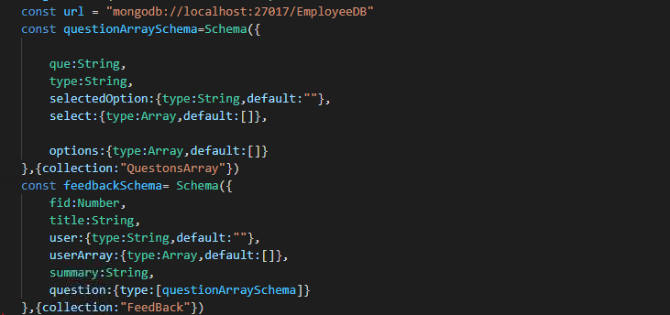
Question and feedback

Slide 17
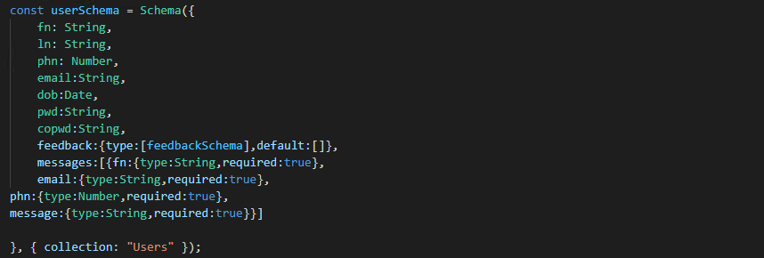
User Schema

Slide 18
Webstorage objects for user tracking
Web storage objects localStorage and sessionStorage allow to save key/ value pairs in the browser.
The sessionStorage exists only within the current browser tab.
Another tab with the same page will have a different storage. But it is shared between iframes in the same tab (assuming they come from the same origin).
The data survives page refresh, but not closing/opening the tab.
setItem(key, value) – store key/value pair. getItem(key) – get the value by key.
removeItem(key) – remove the key with it's value

Slide 19
5.Project overview

Slide 20
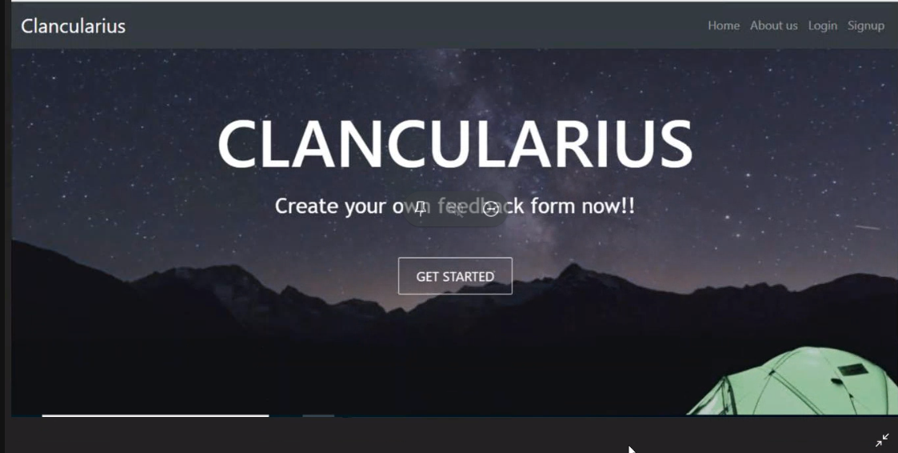
Home page(1)
This is the first page the user lands in when he opens the application, from where he/she can access Clancularius.

Slide 21
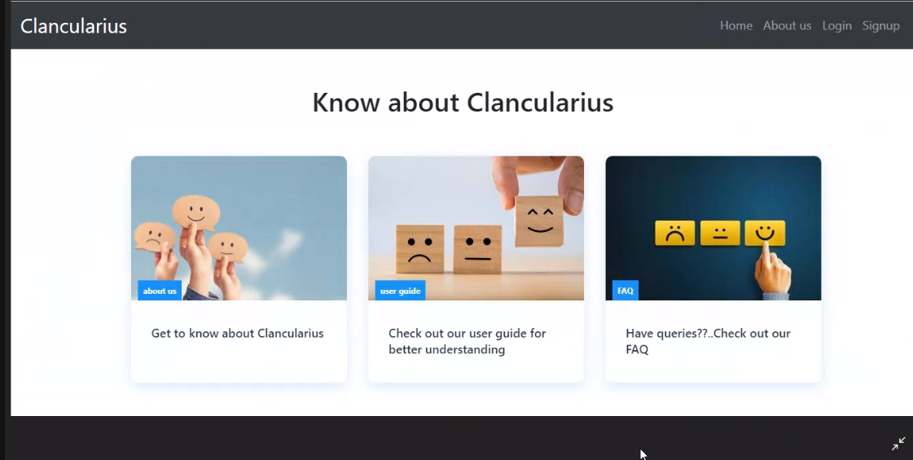
Home page(2)

Slide 22
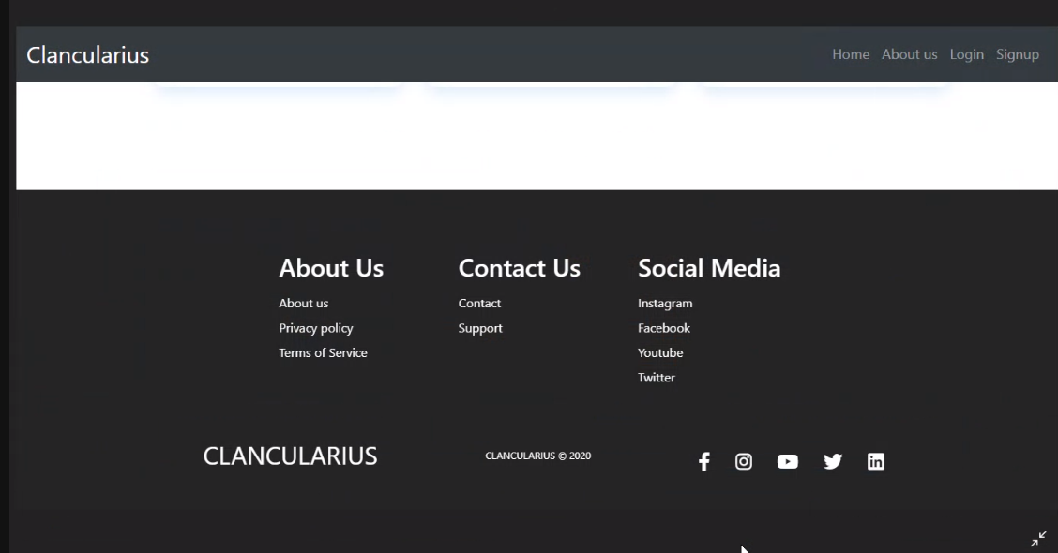
Home page(3)

Slide 23
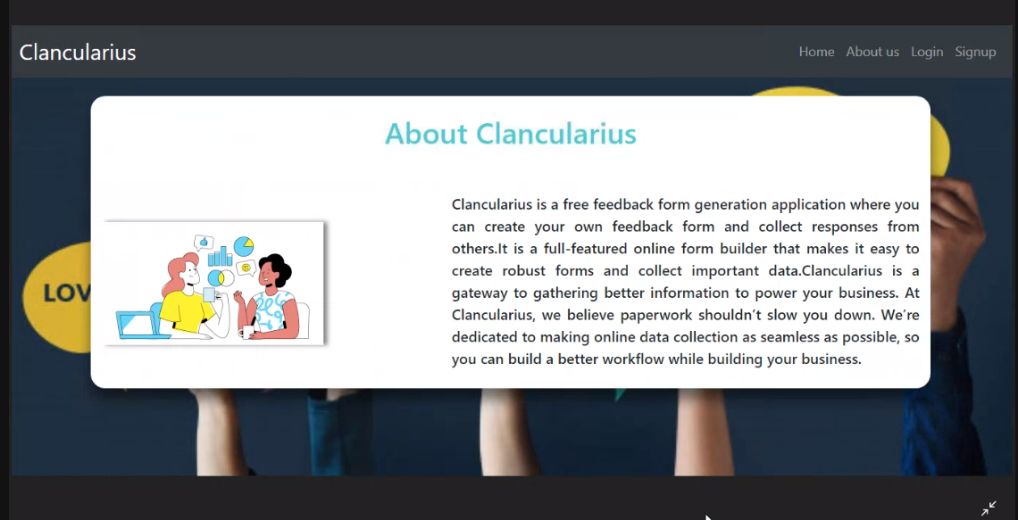
About us
This page serves as an introduction to a naïve user.

Slide 24
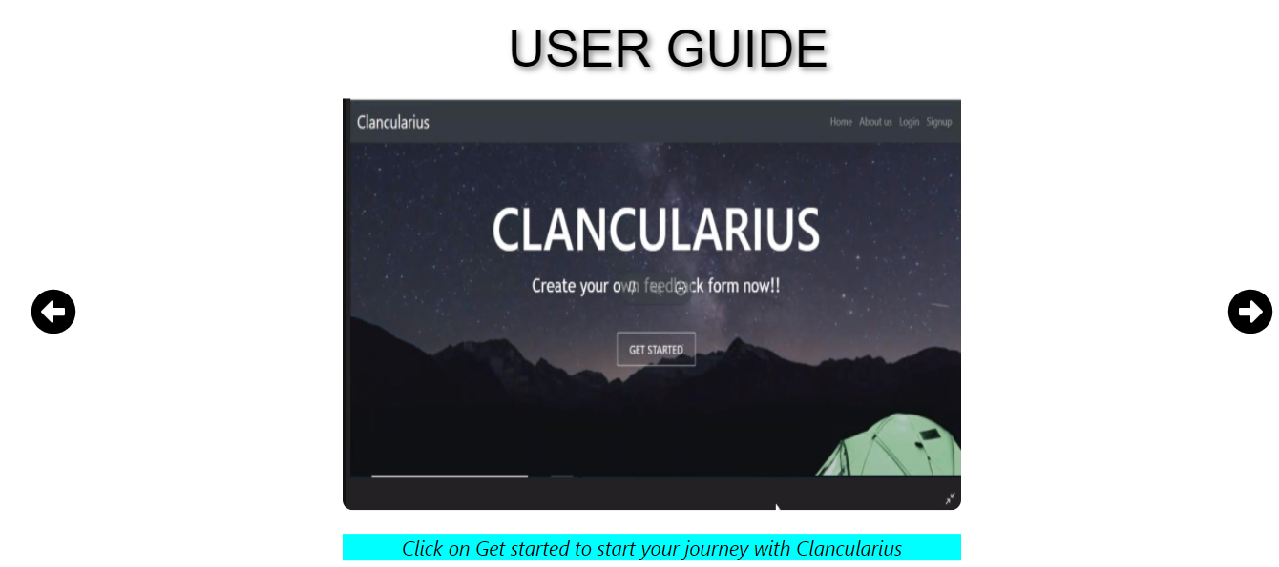
User Guide
A new user can get familiar with the application by going through the slides in this page.

Slide 25
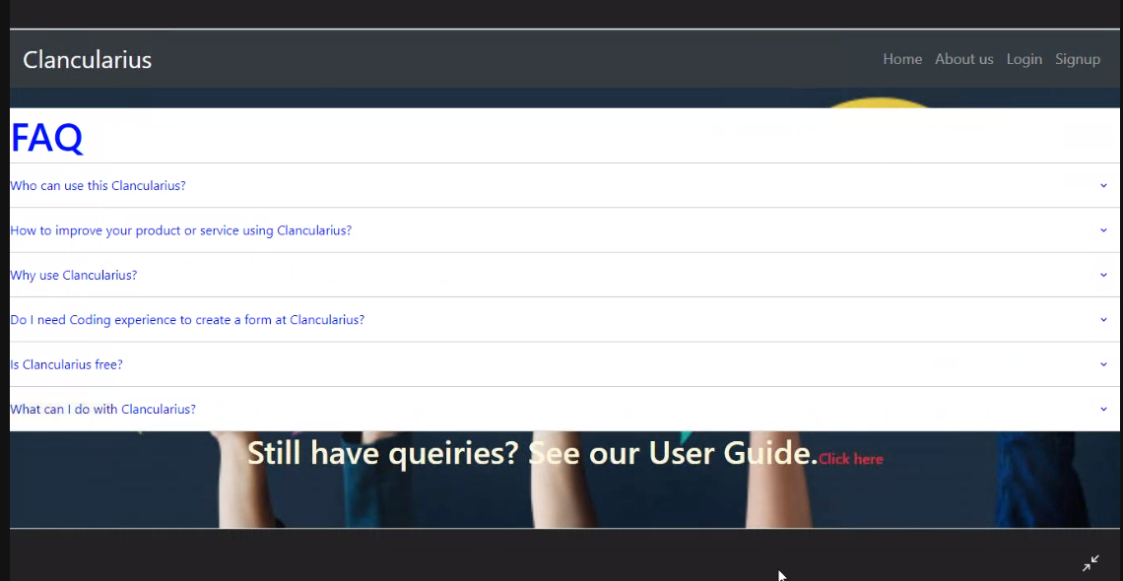
FAQ page
This page contains a set of frequently asked questions and their answers.

Slide 26
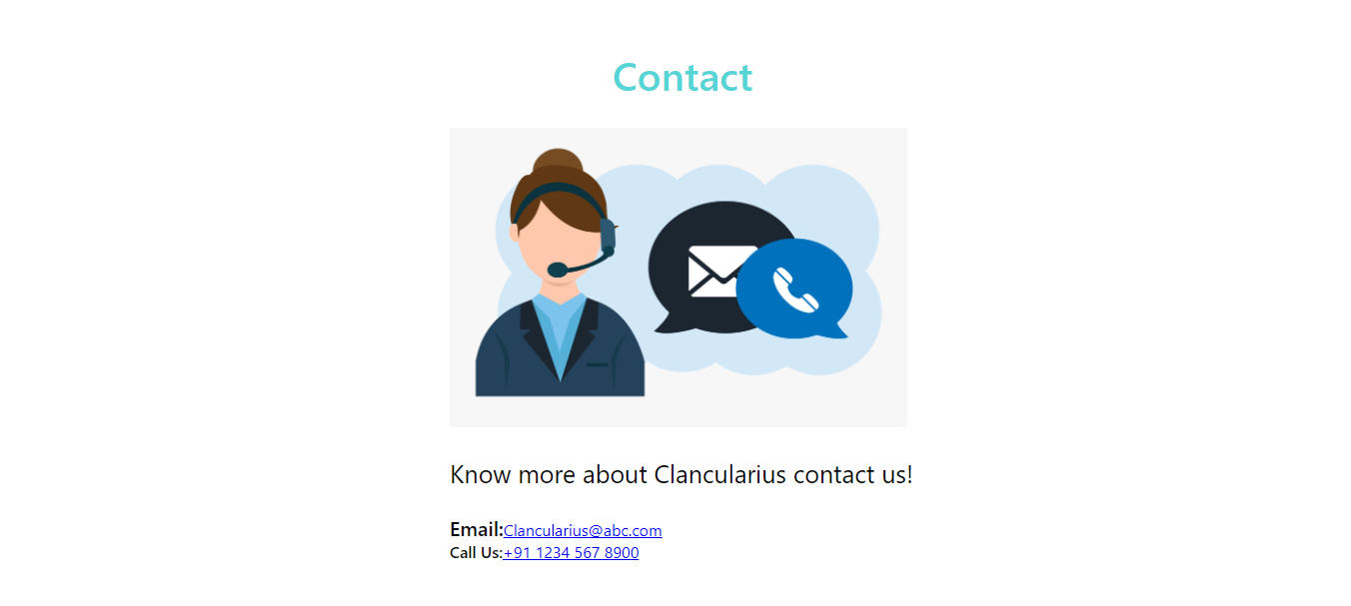
Contact us
This page contains Contact details for any user.

Slide 27
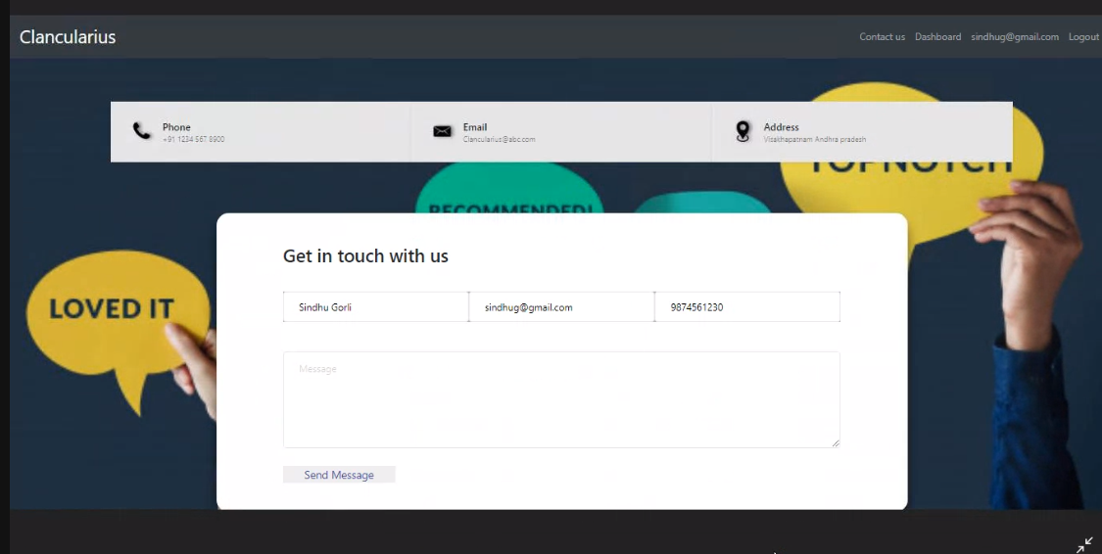
Support page
This can be used to get in touch with admin in case of any difficulty.

Slide 28
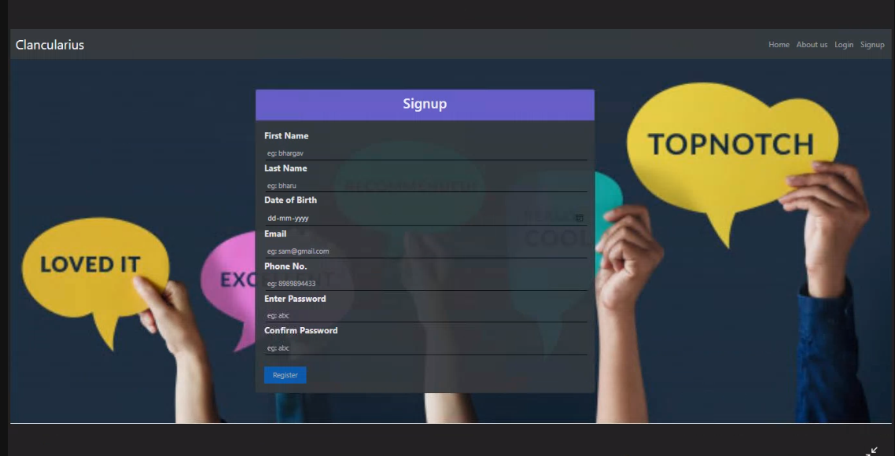
Sign up page
A new user can register himself by providing few details.

Slide 29
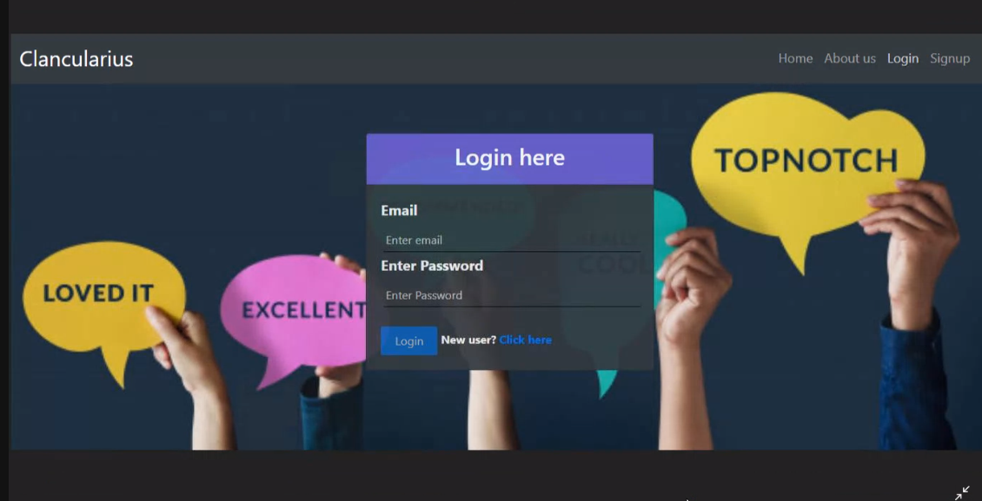
Login page
An existing user can login to the application using his email and password.

Slide 30
Validations for Sign-up
If first name and last name is empty then the respective error message will be displayed.
The date of birth field cannot be greater than today’s date.
If either email id field is empty or of Invalid format is entered then an error message will be displayed.
If phone number field is not within the range of 5999999999 and 999999999 then invalid phone number error message will be displayed.
If entered password and confirm password is not same or any field is left without filling then the respective error message is displayed.
Validations for Login-Page
If entered email is not present in the database the respective error will be displayed.
If password entered is wrong or field is empty then the error message will be displayed.

Slide 31
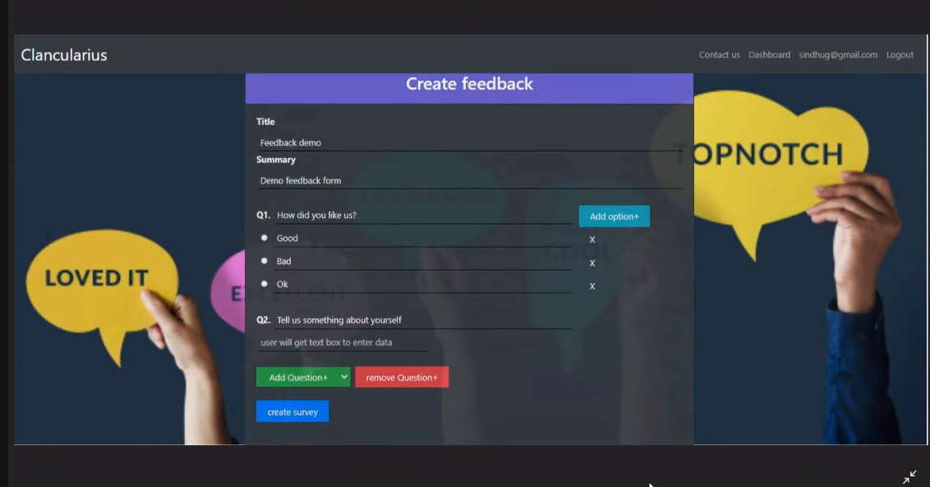
Create feedback page
The user can create the feedback form with different types of questions

Slide 32
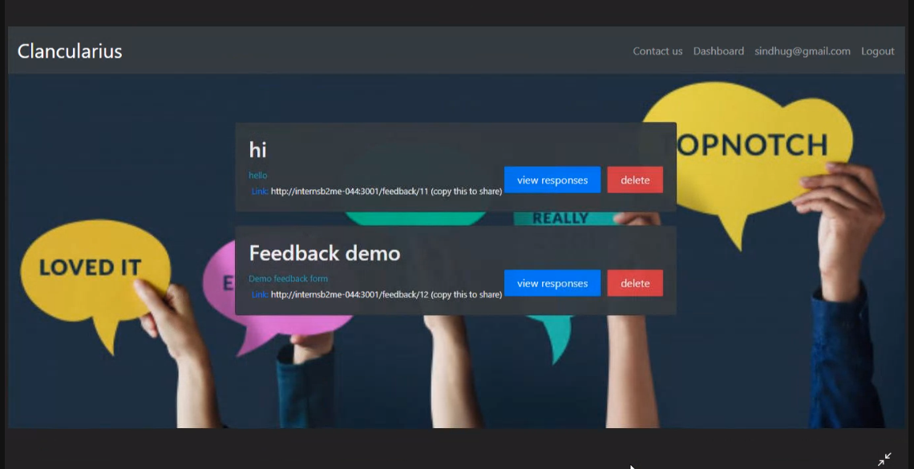
My feedbacks page
A place where the user can see their created feedbacks and responses for each.

Slide 33
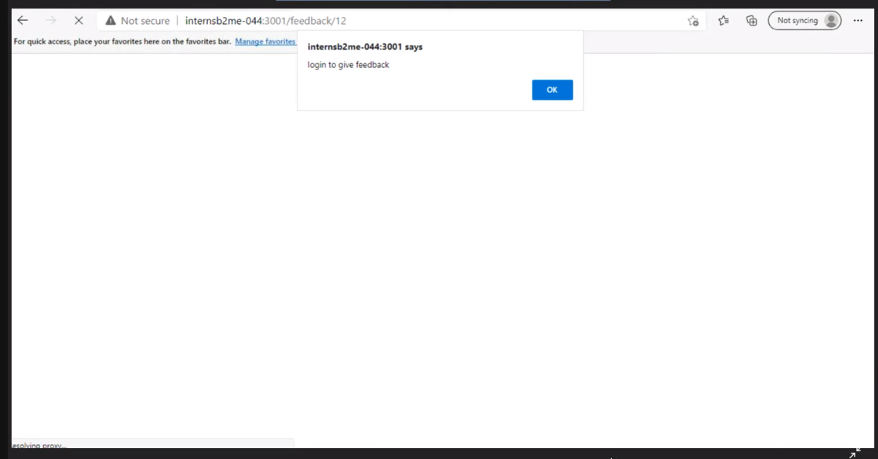
End user login alert to give feedback
When a user enters the feedback link to give feedback he will be alerted to login.

Slide 34
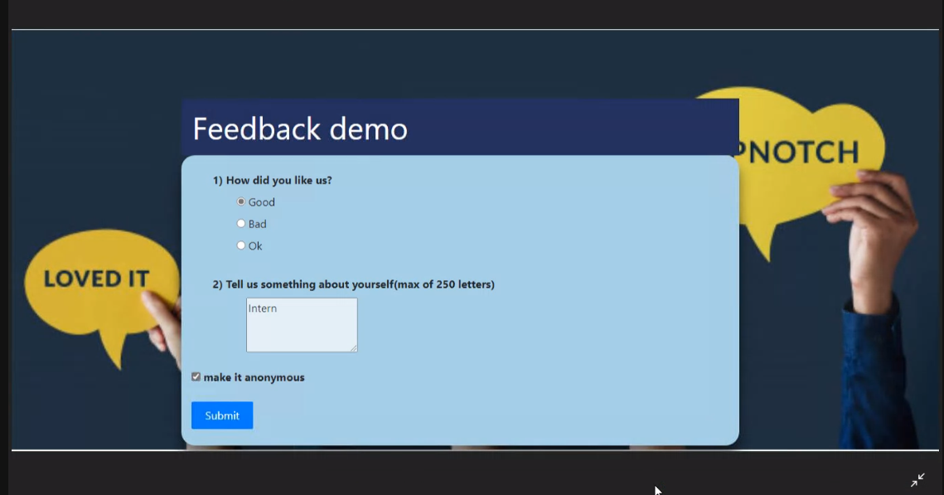
Feedback form
This is the feedback form to respond to the created feedback

Slide 35
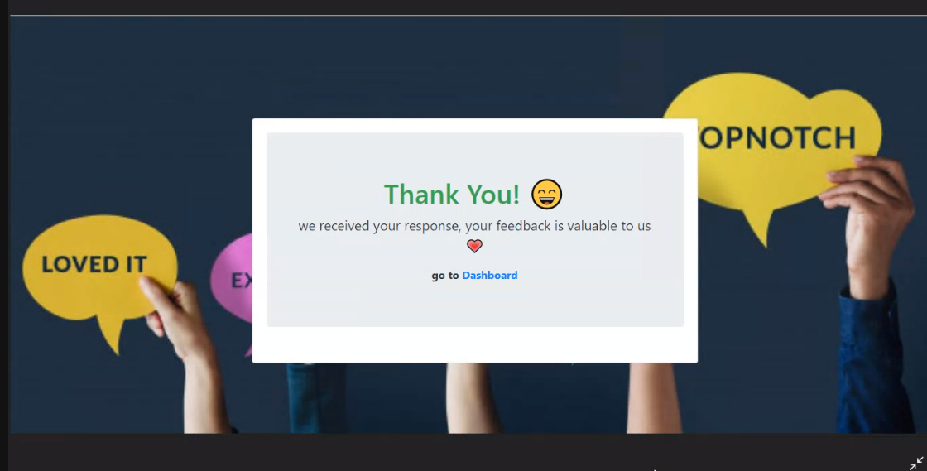
Feedback successful submission
Once a user submits the feedback successfully, this page is displayed.

Slide 36
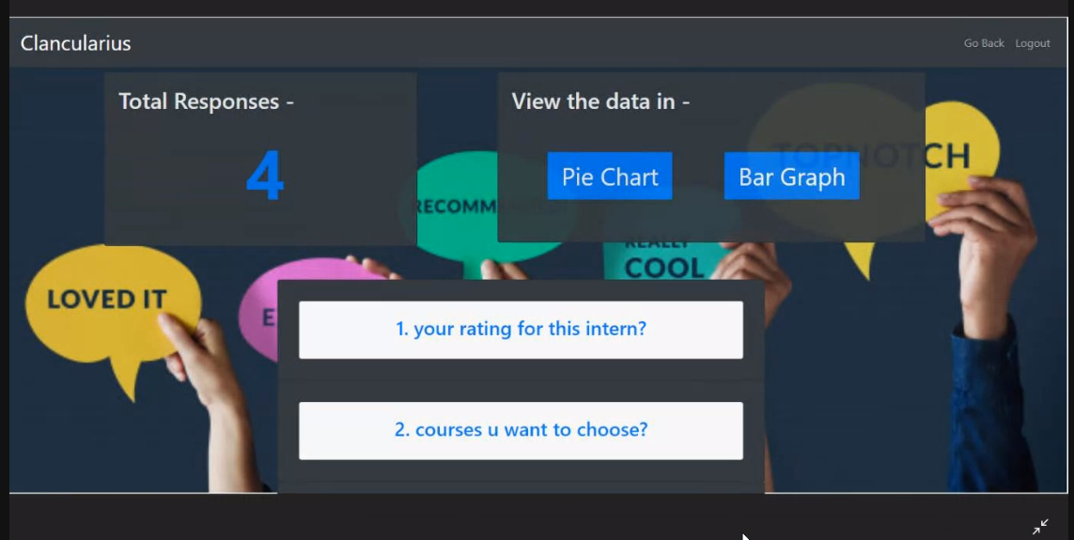
View feedback page
This is the page where the responses of the feedback the user had created can be viewed.

Slide 37
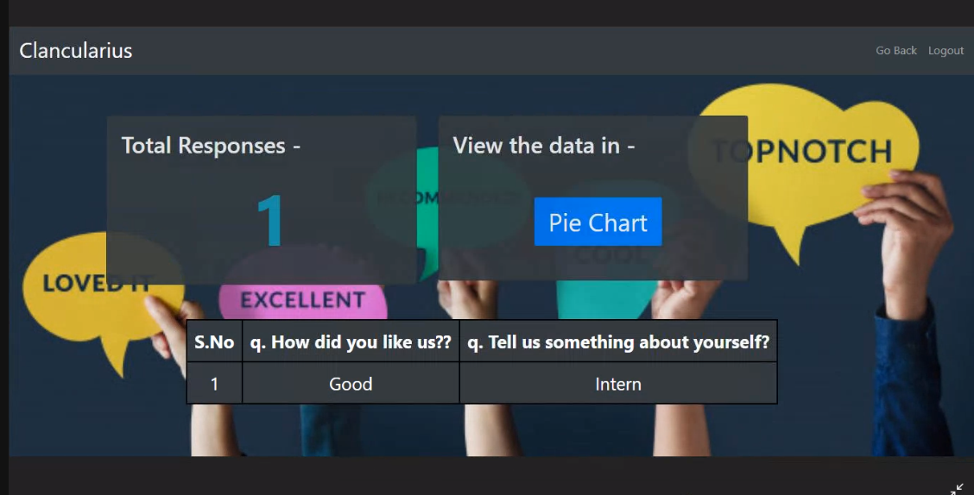
Tabular view of responses
The responses can be viewed in a tabular form as shown below.

Slide 38
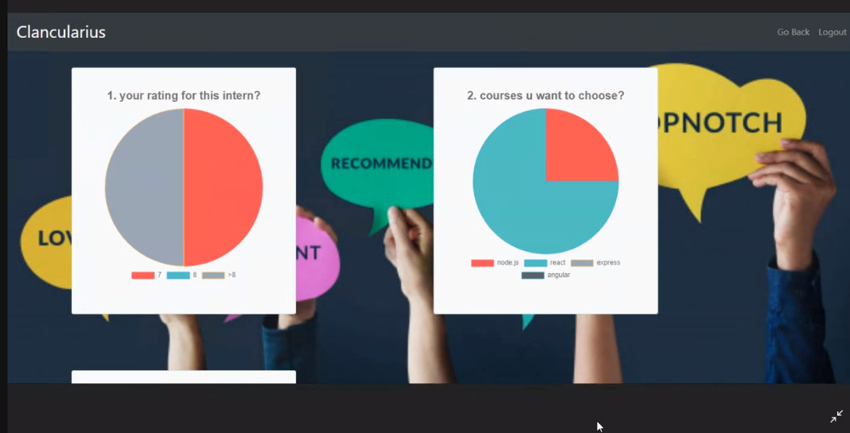
Pie chart view of responses
The responses can also be viewed in a pie chart format as shown.

Slide 39
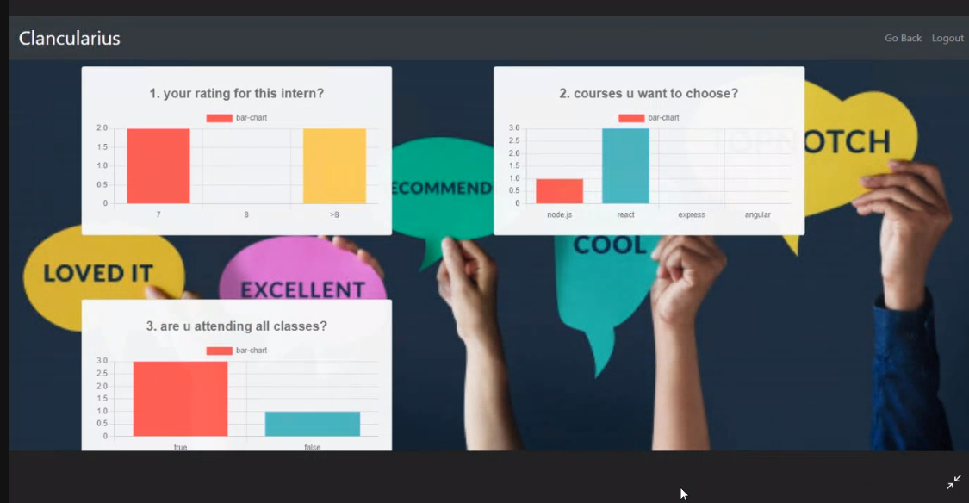
Bar graph view of responses
The responses can also be seen in bar graph format as shown.

Slide 40
Navigation Bar
The navbar is used to navigate to different parts of the application.
The navbar appears on top of every page of our application.
Upon clicking on different contents it navigates to its respective components.

Slide 41
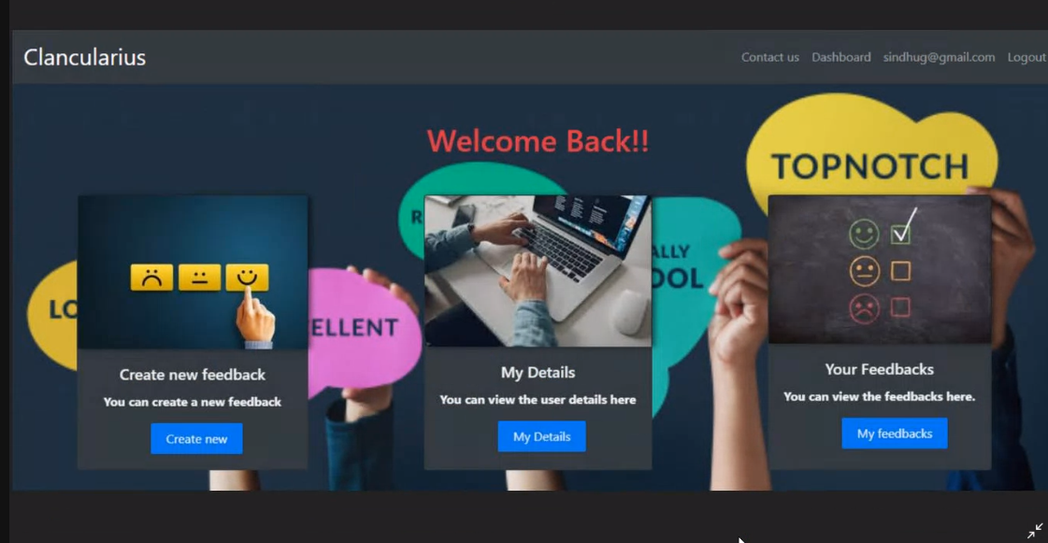
User dashboard
This page is displayed once a user logs in and he/she can navigate to different pages.

Slide 42
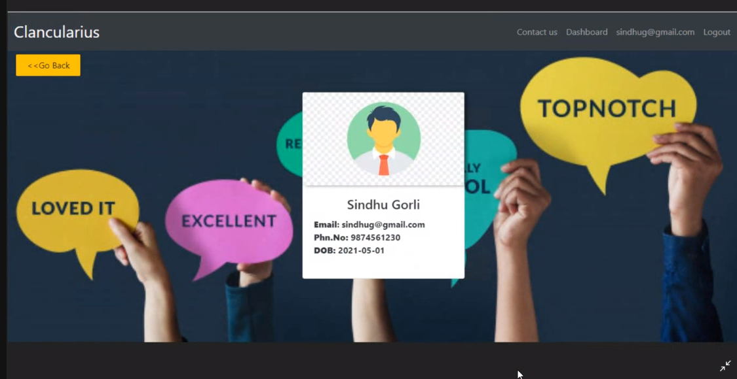
My details page
The details on the current user are displayed here.

Slide 43
6.Conclusion

Slide 44

We successfully created the feedback form generator, Clancularius. It enables you to create Free online forms. It is a free feedback form generation application where you can create your feedback form and collect responses from the public. It is a web application to give anonymous feedback. People can provide feedback anonymously and it will be delivered through the application and the user can view the response. The user can view the response stats through Pie Charts and Bar Graphs.

Slide 45


